Slide 1

Freshens Food Studio Database Modelling
Madhulika Chilla | Ujjwal Garg | Mahima Kriplani | Chethan Manjunath | Ricardo Nunez Magana

Slide 2
Agenda
Company Background and Current Situation
Requirements Analysis/Specification
Conceptual Database design
Logical Database Design
SQL Queries
Business Insights

Slide 3
Company Background and CURRENT SITUATION

Slide 4
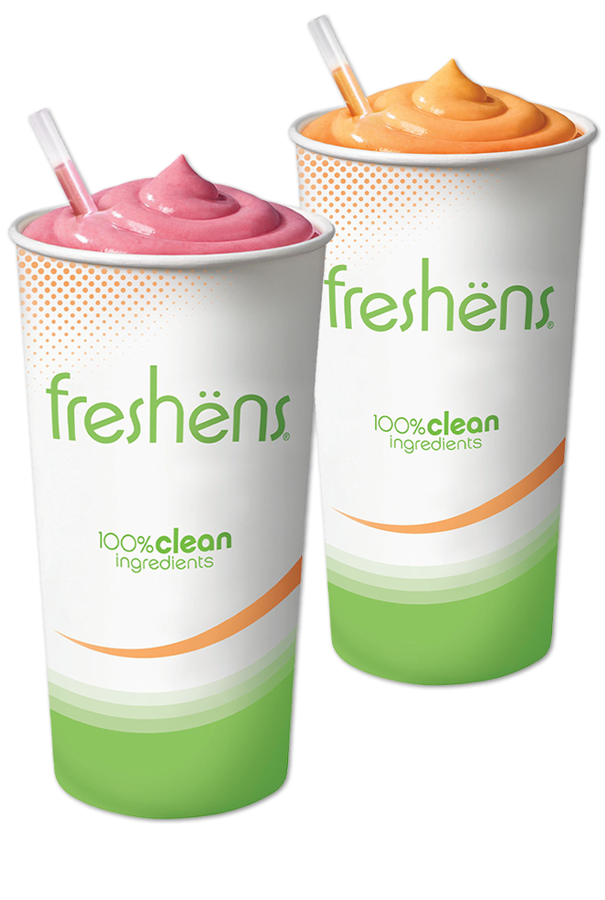
FRESHENS FRESH FOOD STUDIO
Located in the Cordova Recreation Centre, Freshens Fresh Food Studio is Purdue’s ‘healthy fresh casual’ concept offering which serves prepared-to-order food inspired by fresh ingredients. They are centered around creating a culture of health and wellness.
Their signature fresh blended smoothies are extremely popular amongst Purdue students.

Slide 5

FRESHENS FRESH FOOD STUDIO
Freshens does not have a centralized database system to keep track of their data.
Information regarding vendors, customer orders, employees and supplier orders are difficult to access.
Some of their information is stored in spreadsheets, while others can only be found in physical copies.
This rudimentary approach has caused Freshens to struggle to conveniently access the data they need.

Slide 6
Requirements ANALYSIS and Specification

Slide 7
Dataset Description/Specifications
•The dataset consists of 8 entities – employees, position, shift, vendors, items, category, product, orders.
•There are around 50 employees entitled with certain positions. An employee can have only one position, but each position can be held by multiple employees. Employees work in shifts. They can work for multiple shifts and each shift consists of multiple employees.
•The ingredients for the dishes sold are purchased from multiple vendors. Currently there are 30 vendors. Each vendor can supply any number of items to Freshens.
•The ingredients are categorized into 10 categories. Each category comprises of one or many items. And an item belongs to only one category.
•Freshens’ menu comprises of 52 products. Multiple product can be ordered together, and a product can be ordered any number of times.

Slide 8
Conceptual Database Design

Slide 9
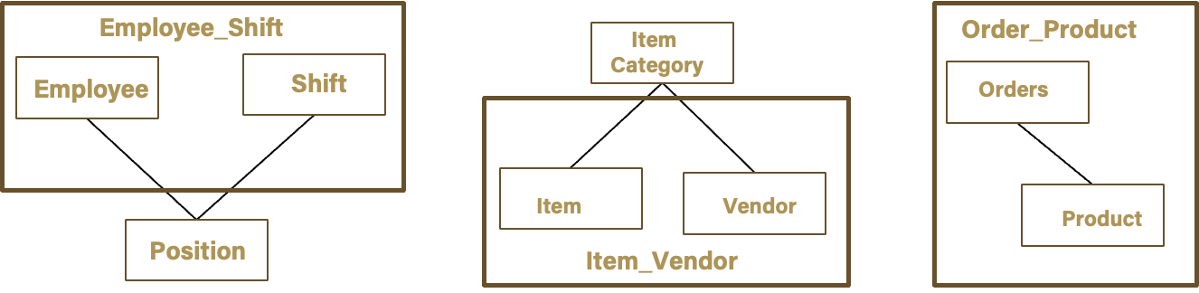
Establish Entities and Identify Relationships/Attributes

Slide 10
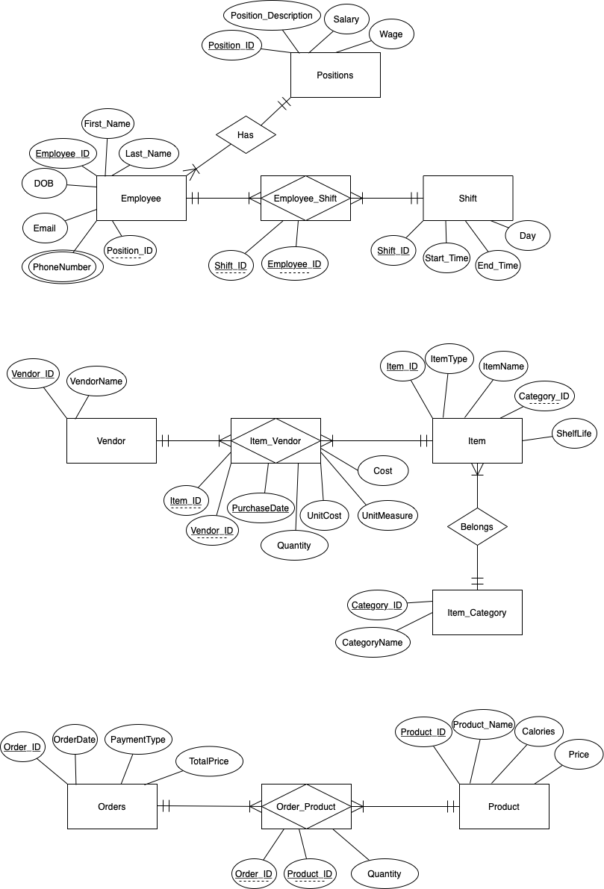
Entity Relationship Model

Slide 11
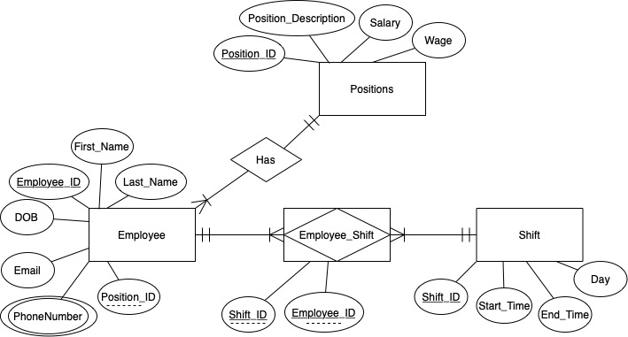
Entity Relationship Model

Slide 12
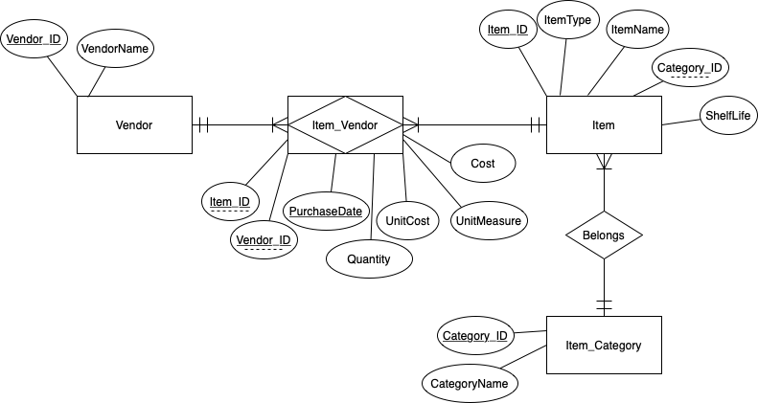
Entity Relationship Model

Slide 13
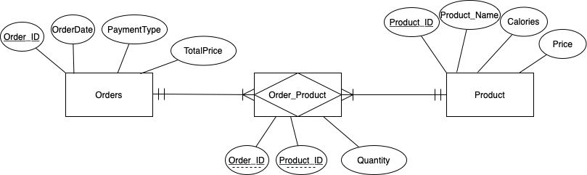
Entity Relationship Model

Slide 14
Logical Database Design

Slide 15
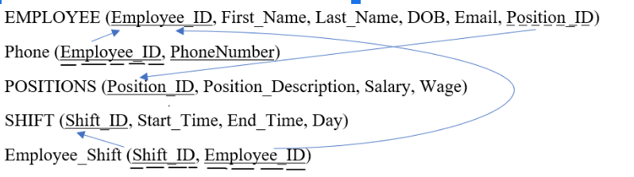
Relationship Schema
Employees, Position and Shift

Slide 16
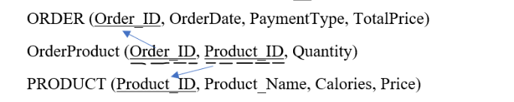
Relationship Schema
Orders and Product

Slide 17
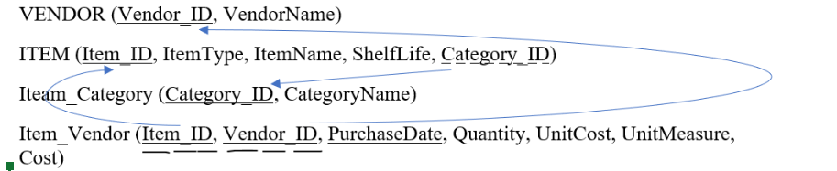
Relationship Schema
Vendor, Items and Category

Slide 18
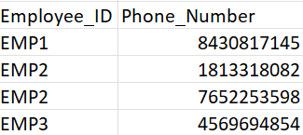
Normalization
1NF

Slide 19
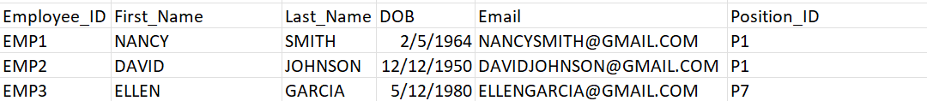
Normalization
3NF

Slide 20
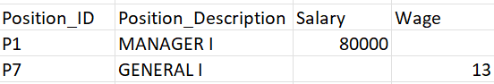
Normalization
3NF

Slide 21
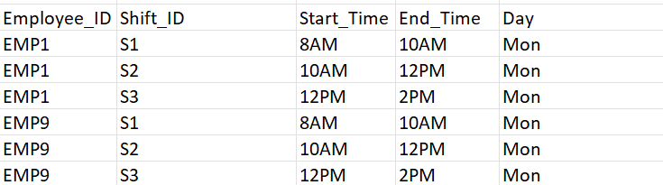
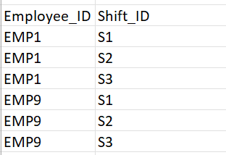
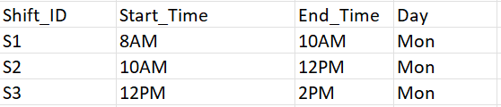
Normalization
3NF
3NF

Slide 22
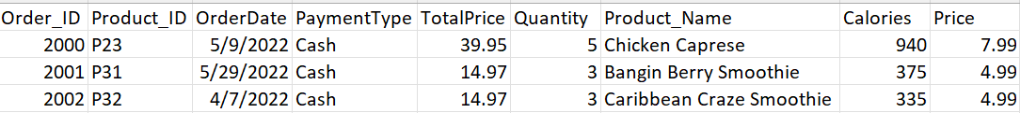
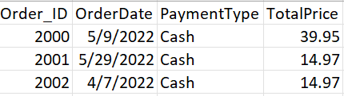
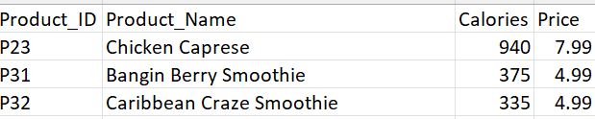
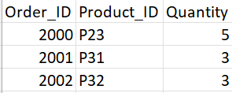
Normalization
2NF
2NF
2NF

Slide 23
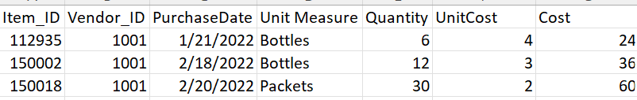
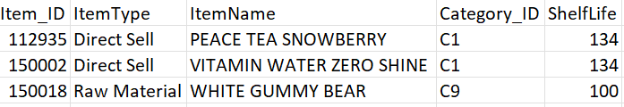
Normalization
2NF

Slide 24
SQL QUERIES

Slide 25
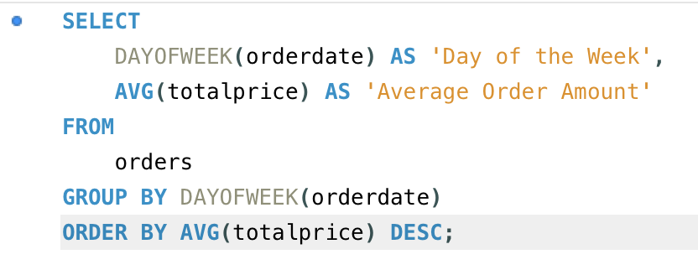
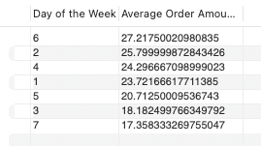
SQL Queries
What is the day of the week with the highest average order amount? How does it compare with the rest of the days?

Slide 26
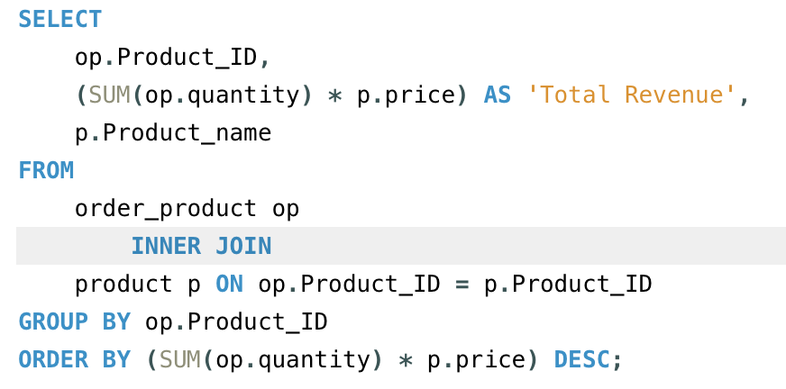
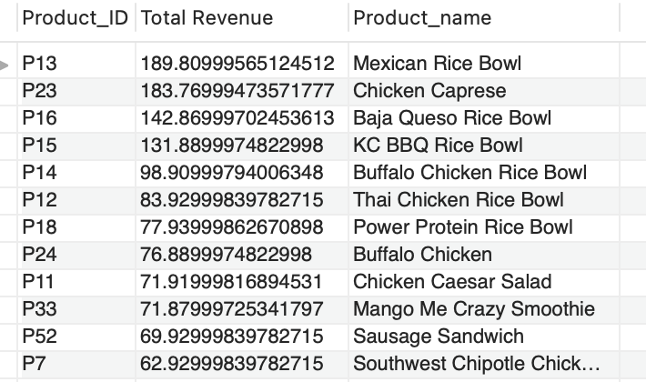
SQL Queries
What is the product that has brought in the most revenue for the company?

Slide 27
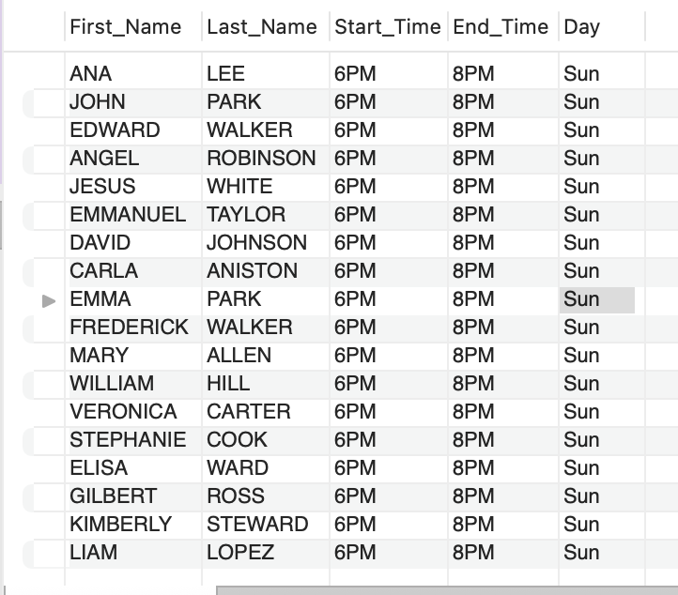
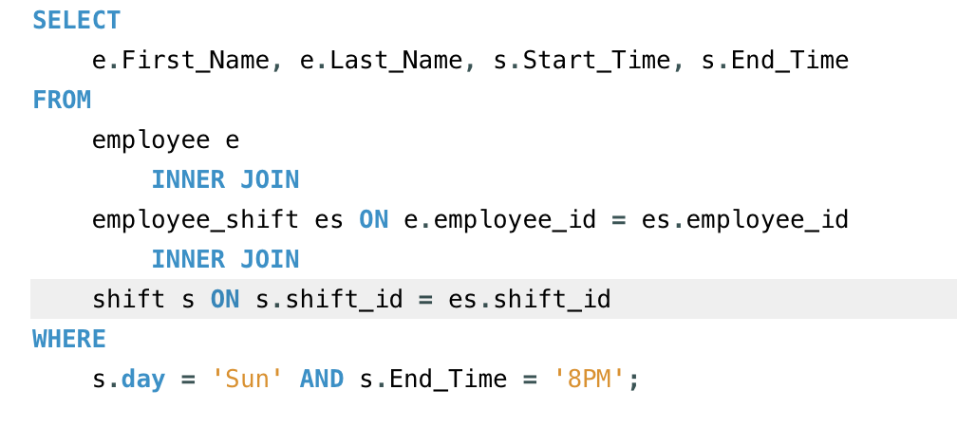
SQL Queries
Who is scheduled to be working on Sunday at closing time?

Slide 28
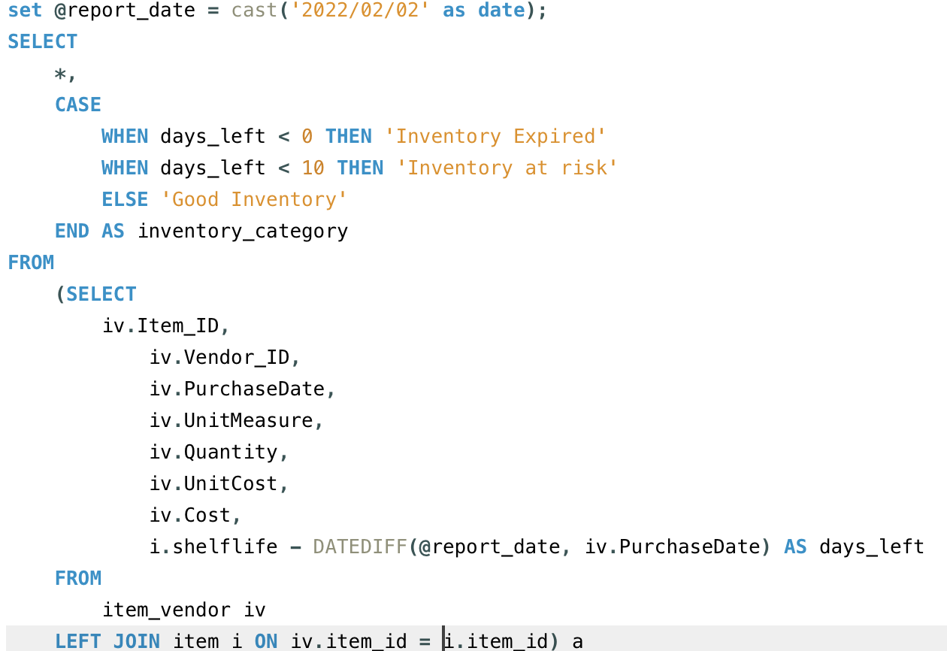
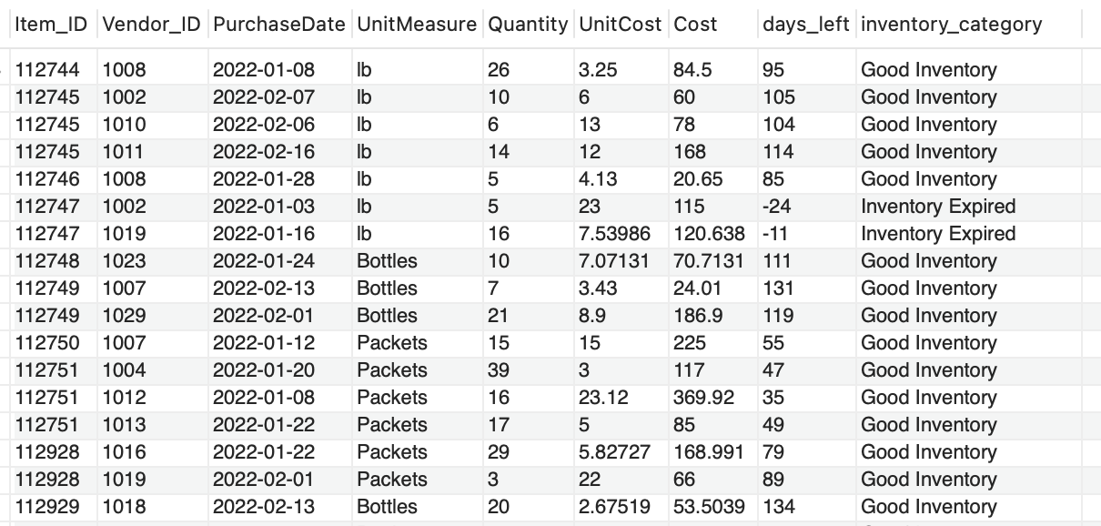
SQL Queries
What is the current inventory that is at risk and what is the risk cost of not using it?

Slide 29
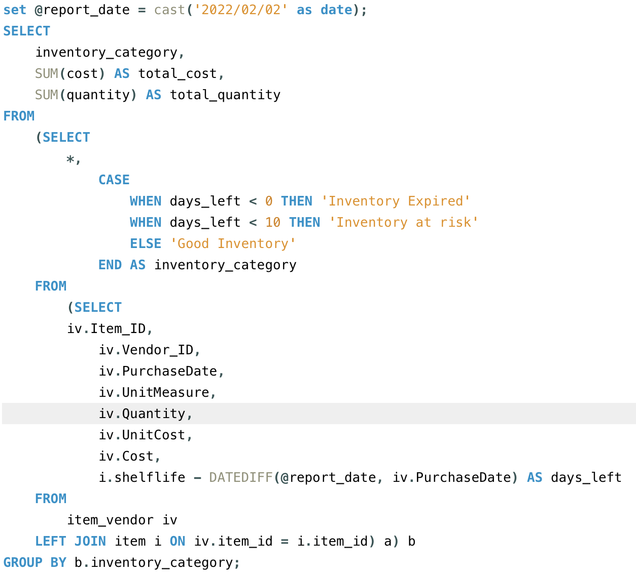
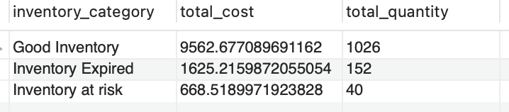
SQL Queries
What is the current inventory that is at risk and what is the risk cost of not using it?

Slide 30
CONCLUSION
Organized data
Key business decisions
Inventory Management
Promotions based on sales
Co-ordination among employees
Shift Distribution
Insights on profits and revenue

Slide 31
Thank You

